Slide 1
Ab Initio – Metadata
Technical Lineage
BICD Data Services CoE - GDW 2.0
April. 2016

Slide 2
Agenda
Introduction
Metadata Capability Stream
What is Metadata?
Function Overview
What is Ab Initio?
How Is Metadata Presented
Walk-through
Operating Model

Slide 3
Introduction

Slide 4
Metadata Capability
Objective of the Team
Implement a centralised, automatically synchronised, metadata repository that accurately reflects physical implementation and ensures currency, completeness and correctness
Integrate all technical metadata types that provide metadata lineage and context enrichment for the Source Extract (TD – Staging) to BAL
Define operating model, train end users and develop roadmap for future metadata integration

Slide 5
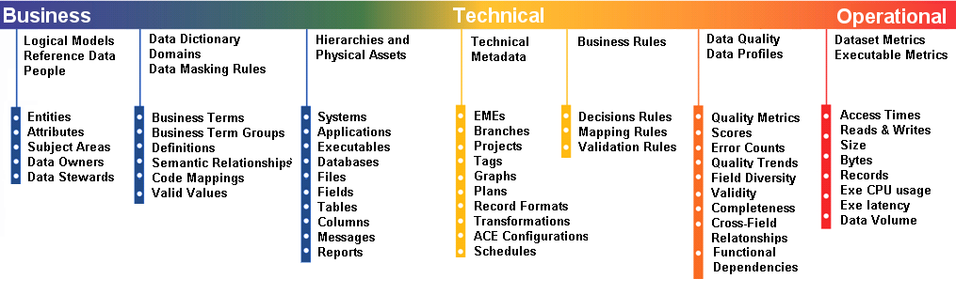
What is Metadata?
Metadata is a foundation capability for a complete Information Management solution and is integral to the development, utilisation and maintenance of a data warehouse architecture
Metadata can refer to any aspect of the data except the intended payload
Metadata can describe
How the data was created ?
Why it was created?
When and where it was created?
Who created & uses it?
Where it is stored?
When, where and how it is used?
What is means?
How it is related to other data?

Slide 6
Coverage (by Metadata Types)
Group | Type | Children
Business | Business Glossary | Terms & Definitions | Semantic Relationships
 | People | Data Owners | Data Stewards
 | Conceptual Models | Subject Areas | Concepts
 | Logical Data Models | Entities | Subject Areas
 | Reference Data | Domain | Domain Value
 | Process | Workflow | Actors
Technical | Interfaces | Extract File Formats | Integration Surfaces
 | Teradata Catalogue | Table/View/Stored Procedure/Macro | Columns
 | BRE | Business Rules | Transformation
 | TCF | Source Code | Job, Transformation
 | Scheduling | Systems, Streams | Job, Relationships
Operational | Execution Logs | Load Logs | Query Logs
 | Process Artefacts | Control Attributes
 | Data Profiling Results ¹ | Source Data | Integrated Data
 | Data Quality Results ² | Failures\Success | Trends
NB: Business Metadata was out of scope
NB: Operational Metadata was out of scope

Slide 7

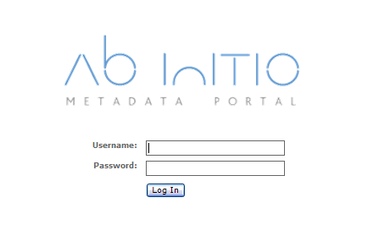
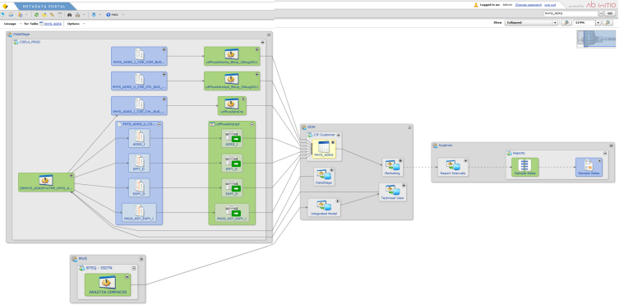
Technical/Business Metadata Imported
TCF
41 control ids/ 4K+ process
Frequency: Fortnightly
BRE
Frequency: Fortnightly
Teradata
5k+ tables/ 5k+ views
Frequency: Fortnightly
Data Models
12 ERwin data models
Technical Metadata (Automated)
Frequency: As Required
Business Metadata (Semi-Automated/Manual)

Slide 8
GDW 2.0 Metadata Coverage

Slide 9
Function Overview

Slide 10
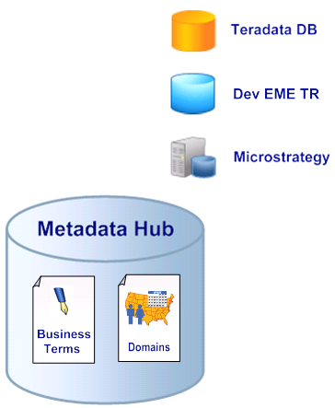
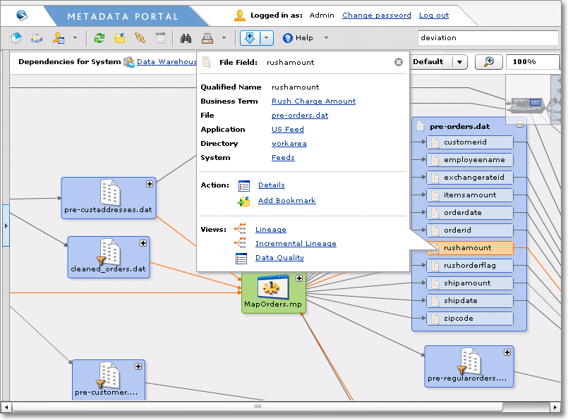
What is Ab Initio?
An Ab Initio deployment consists of:
The Metadata Hub
The Metadata Portal
The Metadata Hub is an enterprise-class, enterprise-scale solution built from first principles to gather, store, manage and analyse metadata
The Metadata Hub can act as an extensible, enterprise data-warehouse for metadata, a metadata system of record and a historical metadata archive with complete version history.
The Metadata Portal is a customisable, browser-based user-interface designed from first principles to make the enterprise-wide metadata available & understandable
It is an environment where users can search, view, query, analyse and examine all of the diverse metadata.

Slide 11
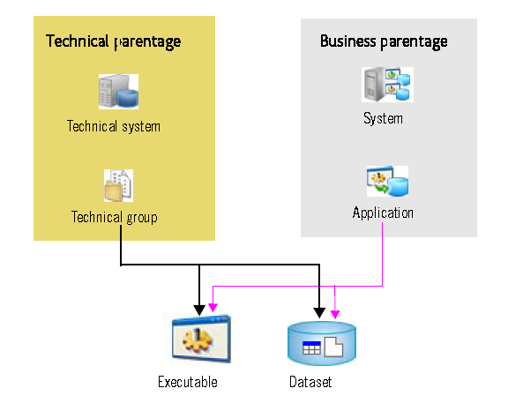
How is Metadata Presented
System
An object class that provides an organizing mechanism for grouping applications into a meaningful hierarchy in MetaHub lineage views.
Application
A child of the System object class, which provides means of grouping datasets and executable into business function.
Technical and Business Hierarchy
Navigate through Hierarchies > Physical Assets
Navigate through Systems and lineage views

Slide 12
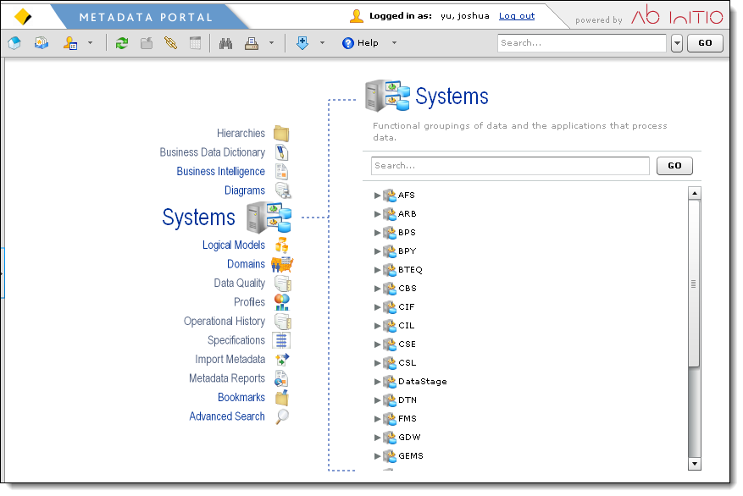
MetaHub Portal
Move cursor onto and click each entry here to browse its contents
Expand the node, or click it to see details

Slide 13
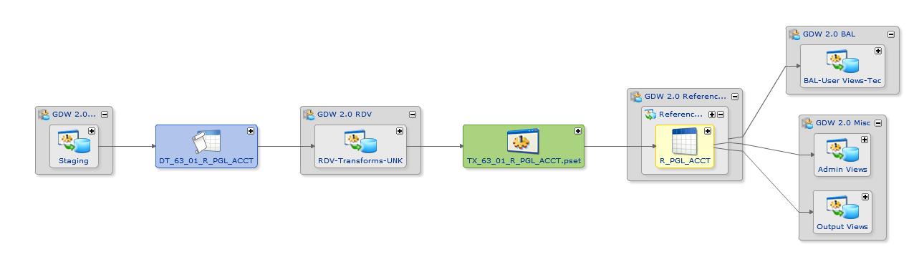
Lineage View
Lineage view displays dependencies and flows of data, and programs/executables that process data.
Data Lineage & Impact Analysis

Slide 14
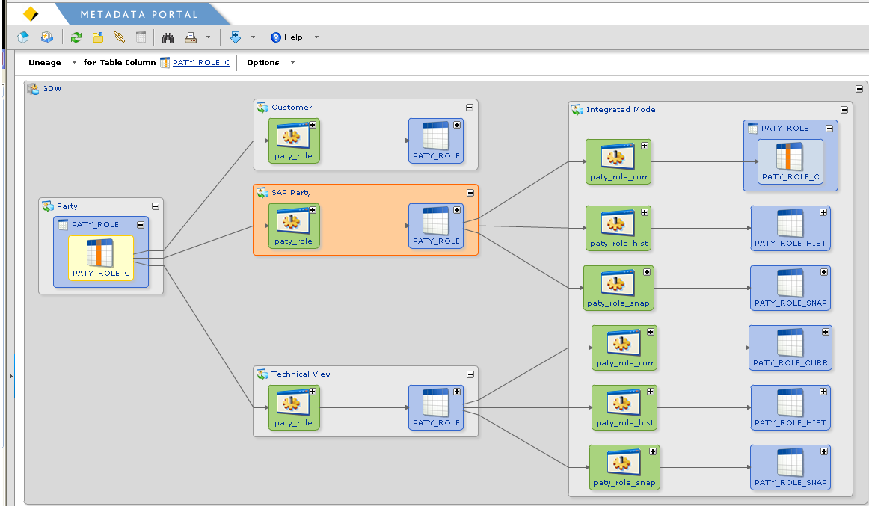
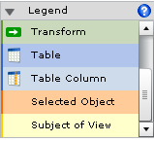
Lineage Diagram – Tips & Hints
Options Diagram or Tabular View
Orange box: Currently selected i.e. cursor
Light Grey box is an application
Blue box is dataset: table or view or file
Home to start a new analysis
Grey box is a system
Yellow box represents the start-point
Important
Click + to expand and - to collapse
Green box is an executable: transformation, BTEQ script, Cobol, DataStage job
Green box is an executable: view transformation, BTEQ script, Cobol, DataStage job etc
Blue box is dataset: table, column, view or file;
Orange box is what is currently selected i.e. cursor
Yellow box is the current focus of the Ab Initio system - IMPORTANT

Slide 15
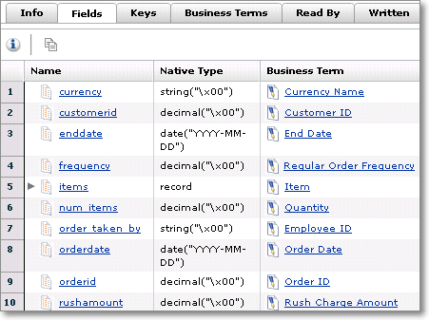
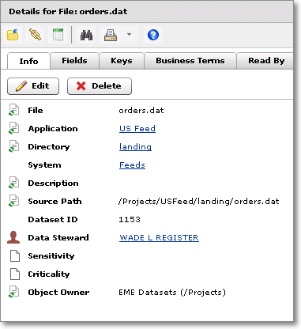
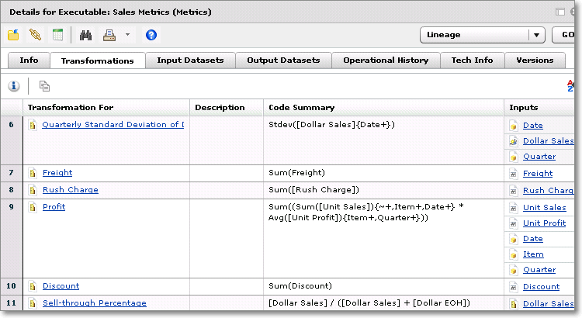
DataSet & Executable
DataSet can be a file, table, view, message, or dimension. Executable can be an ETL job, BTEQ SQL script, Cobol program or stored procedure.
Dataset & Executable Details

Slide 16
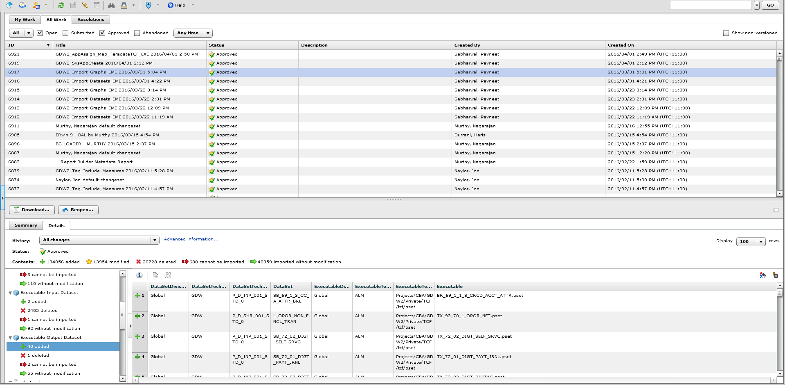
Change History
Any change to the metadata object is preserved into history, including who did the change, who approved them, when, and what are changed.
Data Stewards, Change set and update history

Slide 17
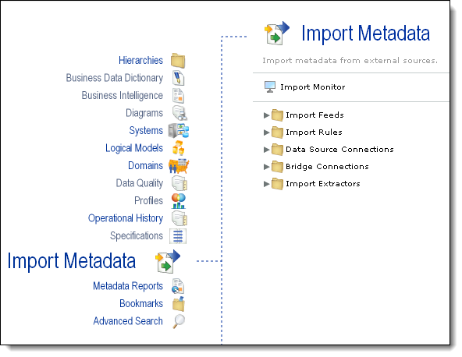
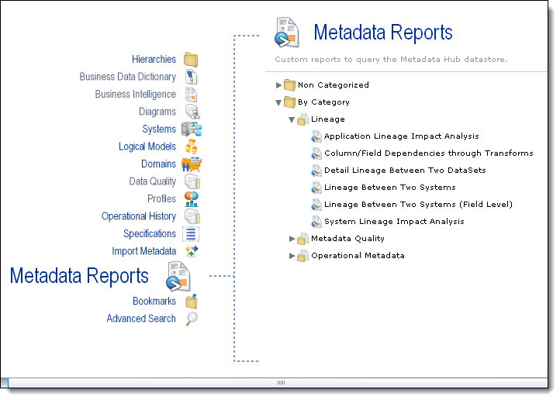
Import Metadata From Sources
Custom views for each kind of metadata make it easy to discover, explore and understand the metadata.
Metadata Reports, Import Feeds & Import Rules(Editor, Approver & Administrator only)

Slide 18
Send your question to BICD Data Services CoE <BICDDataServicesCoE@cba.com.au>

Slide 19
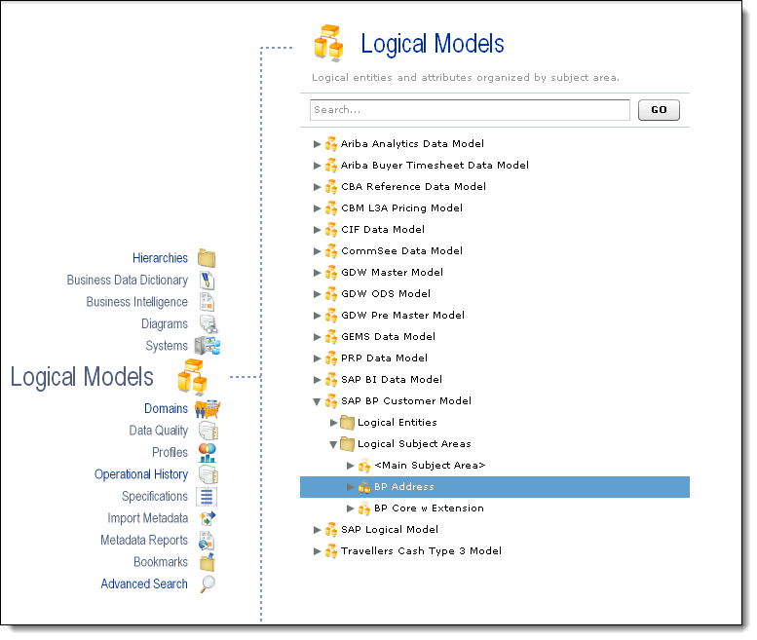
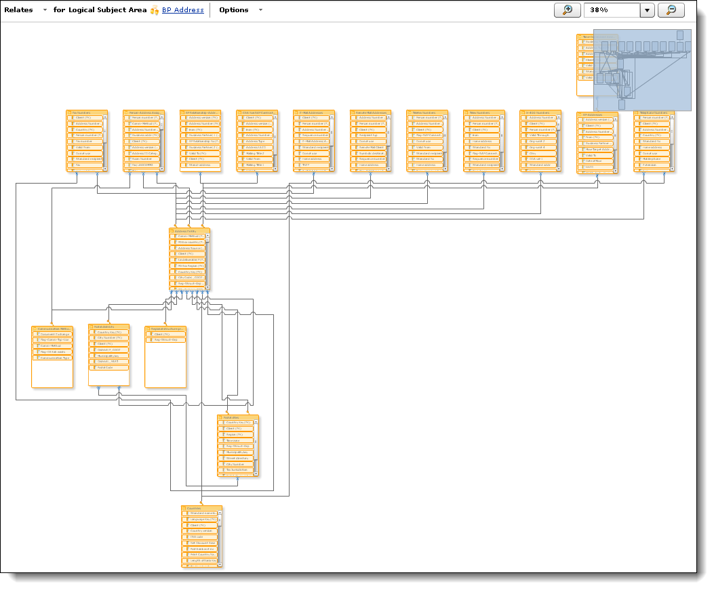
Logical Data Model
Logical models are created in modeling tool like CA ERwin, and describe data using subject area, entity, attribute, domain and key.
Logical & Physical Data Model

Slide 20
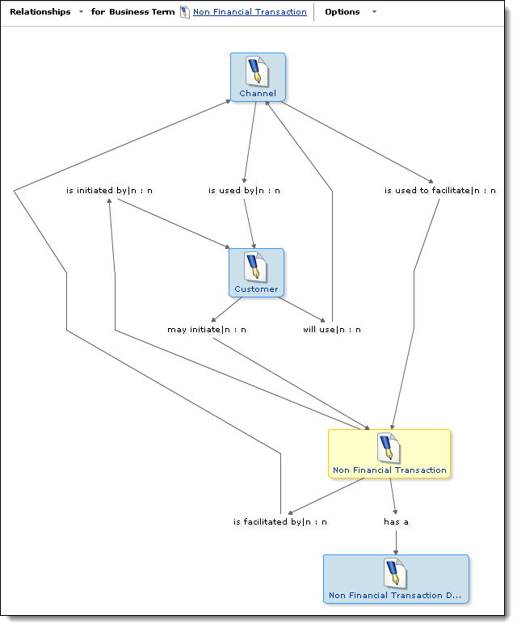
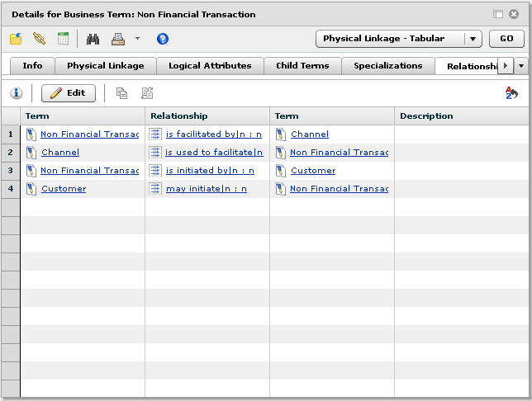
Business Data Dictionary – Only for GDW 1.0
Business Data Dictionary consists of term group, term and relationship between terms.
Business Glossary : Terms & Domains

Slide 21
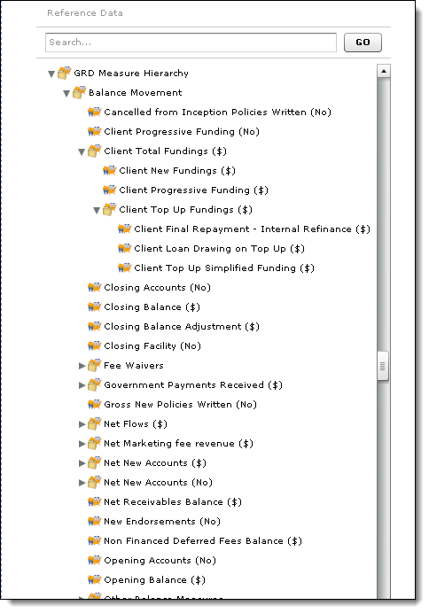
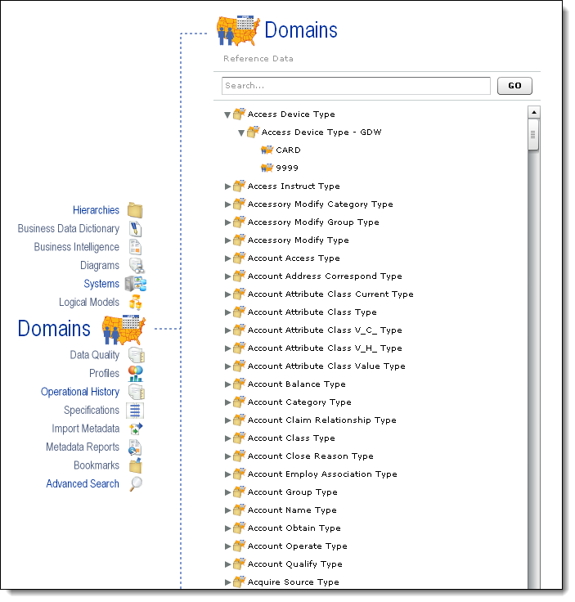
Reference Data – Only for GDW 1.0
Reference data can be found in Domains, where reference data name and values are organized in an hierarchical manner.
Reference Data : non-hierarchical & hierarchical

